Slide 1
Fast, Exact and Scalable Dynamic Ridesharing
Valentin Buchhold, Peter Sanders, Dorothea Wagner
Notes:
The paper proposes an improvement to the ridesharing problem. The problem is important to for the practical application for large fleets of autonomous vehicle, which might be crucial for the future. Finding a solution for the entire set of vehicles is NP-complete, so most practical implementations process the requests one by one and aim to minimize the increase in the driving time of any vehicle.
The propsed work covers searching in graphs using Dijkstra, Contraction Hierarchies (CH), CustomizedCH, BucketCH and the algorithm which makes use graph searching optimized for the ridesharing problem and constraints.
Their algorithm LOUD is based on contraction hierarchies (CH) with local buckets. The algorithm maintains the forward and reverse CH search spaces, aggressively pruning of the buckets so that only those entries that can possibly contribute to feasible insertions.

Slide 2
Introduction
DARP, TSP
Evaluation is done on large-scale simulations of the real world
Current methods require many Dijkstra’s shortest path calls
The algorithm knows the current routes of a fleet of vehicle and each vehicle number of seats
The task is to insert a ride request into a vehicle’s route and minimize the total operation cost of the fleet
Constraints on the maximum wait time and the maximum travel time for riders to reach their target destination
Notes:
Dynamic ridesharing is related to the Dial-a-ride problem (DARP) problem in operations research. The DARP primarly considers small instances and solutions where all ride requests are known in advance.
Travelling salesman problem with time windows
MATSim
T-Share algorithm and grid paritions using shortest-path distances using hub labeling and caching
Dynamic carpooling - drivers can specify fixed source and target and can pick up and drop off passengers thus sharing the cost of the ride. All constrains also apply to drivers

Slide 3
Computing shortest paths
The problem of quickly computing shortest paths in weighted graphs given auxiliary data
CH - point to point route planning faster than Dijkstra’s algorithm
CCH - variant of CH that can handle updates to the edge weights quickly
BCH - CH with buckets:
bucket B(v) contains all vertices which appear in the search space of vertex v within a given distance
LOUD - BCH + bucket pruning + filtering technique for promising vehicles
decreases search space by 20 times
Open-Berlin-Scenario : 30 times faster than industry and academia proposed solutions

Slide 4
Problem statement
Road network : directed graph G=(V,E)
V - intersections
E - road segments
L(v, w) - travel time between v and w
dist(v, w) - shortest-path distance from v to w
Vehicle
l_{i} - initial location
c - seating capacity
[t_min, t_serv_max] - service interval
R(v) = <s₀, …, s_{k}> - sequence of stops s, at locations l(s) element of V, already scheduled for the vehicle
At each stop, the vehicle picks-up and/or drops off one or more riders
Each stop takes t_stop time, independent of the number of riders

Slide 5
Problem statement
Vehicle
Vehicle route is continuously updated.
Vehicle stop - s_0 is the current stop
Vehicle driving - s_0 is the previous stop, vehicle location is between s_0 and s_1
Idle vehicles prolong their last stop
Request
r = (p, d, t_dep_min) - pickup location, drop off location, earliest departure time
no pre-booking allowed

Slide 6
Constraints
insert request into any vehicle’s route, such that the vehicle’s operation time δ is minimized
ι = (v, r, i, j) - vehicle v, picks up request r, after stop s_i and drops off after stop s_j
vehicle capacity constraint and service time constraint
t_wait_max - for a matched request r’, the wait time must not exceed threshold
t_dep_max(r’) = t_dep_min(r’) + t_wait_max
trip time
t_arr_max(r’) = t_dep_min(r’) + t_trip_max(r’) = t_dep_min(r’) + α * dist(p(r’), d(r’)) + β
objective value to minimize
f(ι) = δ + 𝛾_wait * max{t_dep(p(r)) - t_dep_max(r), 0} + 𝛾_trip * max{t_arr(d(r)) - t_arr_max(r), 0}
Notes:
Objective value is a soft constraint to minimize for the given insertion.
ι = “iota”

Slide 7
Dijkstra's algorithm
Computes the shortest-path from source vertex to all other vertices
s - source vertex
distance label - d_s(v)
Q - priority queue of vertices with distance label as keys
initialization : Q = {s}, d_s(s) = 0, d_s(v) = ∞, for each v != s
Repeat until Q is empty:
extract vertex v from Q
relax outgoing edges e=(v, w)
if d_s(v) + l(e) < d_s(w): d_s(w) = d_s(v) + l(e)
insert w into Q

Slide 8
Contraction Hierarchies (CH)
vertices that hit many shortest paths are considered more important (such as highways)
add shortcut edges between neighbours of important vertices
witness search - local Dijkstra
query phase:
bidirectional Dijkstra only relaxing edges leading to higher rank vertices
CH forward search from source and reverse CH search from target until the search frontieres meet

Slide 9
BCH
one source s, many targets t are elements of V
Ds(t) - tentative distance from s to v
B(h) - bucket for vertex h
reverse CH from each t
insert each settled h into B(h) as (t, dt(h)) - shortcut from h to t with length dt(h)
forward CH from s
loop for each h settled over all entries (t, dt(h)) elements of B(h)
if ds(h) + dt(h) < Ds(t): Ds(t) = ds(h) + dt(h)
many to many
each bucket stores entries from several s to h

Slide 10
Solution
request insertion (v, r, i, j)
BCH to find :
dist(s_i, p)
dist(p, s_i+1)
dist(s_j, d)
dist(d, s_j+1)
maintains for each vertex h, Bs(h) and Bt(h)
LOUD
elliptic pruning - stops s_i and s_{i+1} must lie inside a shortest-path ellipse
ellipse is the set of vertices : dist(s_i, v) + dist(v, s_i+1) <= λ

Slide 11
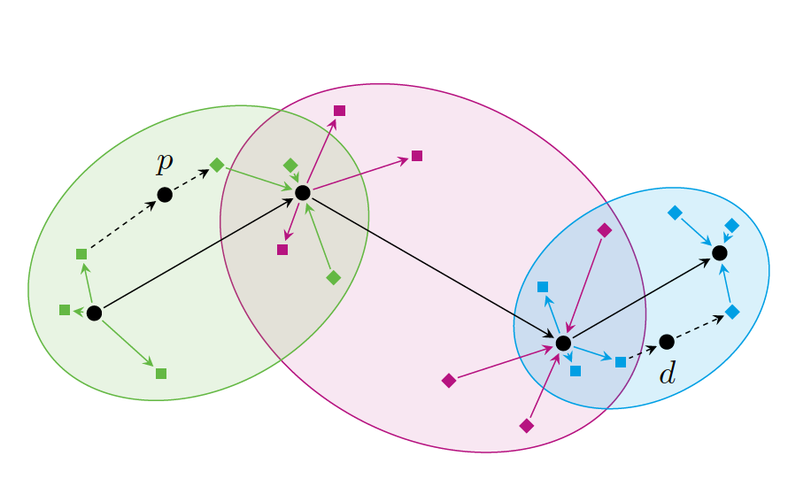
Bucket entries and insertion
Notes:
A vehicle's route consisting of four stops and
the bucket entries induced by them. The stops are
shown as circles and the leeway between two consecutive
stops is shown as an ellipse. Source bucket entries are
shown as edges with square-shaped heads and target
bucket entries are shown as edges with diamond-shaped
tails. Green, lilac and blue bucket entries are pruned by
the respective ellipse. Consider a request r = (p; d; tmin
dep )
where p is to be inserted immediately after the rst
stop s0 and d immediately before the last stop s3. Note
that the shortest paths from s0 to s1 via p and from s2
to s3 via d lie entirely inside the respective ellipse.

Slide 12
Algorithm
Shortest-path distances from pickup p to drop-off d using standard CH query
Find ordinary insertions costs using two forward BCH searches and two backward BCH searches (from p and d)
Trying all ordinary insertions that satisfy capacity constraints and the hard constraints
Trying special-case insertions

Slide 13
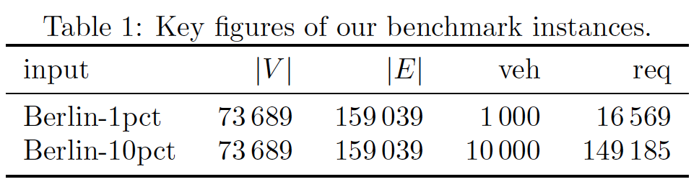
Open Berlin Scenario

Slide 14
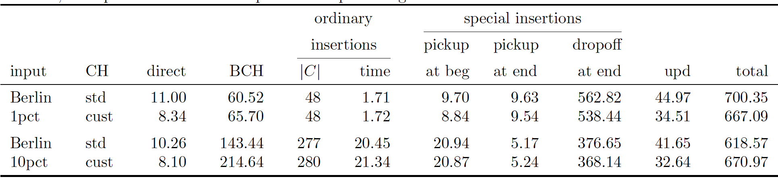
Performance
Notes:
Table 4: Performance of resolving ride requests on various benchmark instances with standard and customizable
CH. We report the time to compute the shortest direct path from the pickup to the dropo spot, the time for the
BCH searches, the time to try all ordinary candidate insertions, the time to treat the special cases (pickup before
the next stop, pickup after the last stop, and dropo after the last stop), the time to update the preprocessed data
(including bucket entry generation), and the total running time. All running times are given in microseconds. In
addition, we report the size of the superset C of promising candidate vehicles.

Slide 15
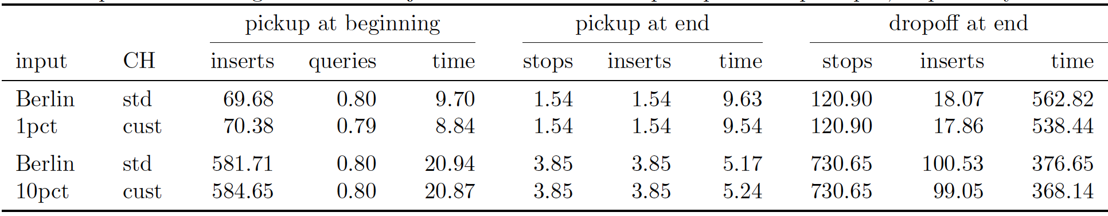
Special case treatments
Notes:
Table 5: Detailed statistics about the special-case treatments on various benchmark instances with standard and
customizable CH. For each special-case treatment, we report the number of insertions tried and the running time
(in microseconds). For handling pickups before the next stop, we additionally report the number of CH queries
needed per ride request. For handling pickups and dropo s after the last stop, we additionally report the number
of last stops visited during the reverse Dijkstra searches from the pickup and dropo spot, respectively.

Slide 16
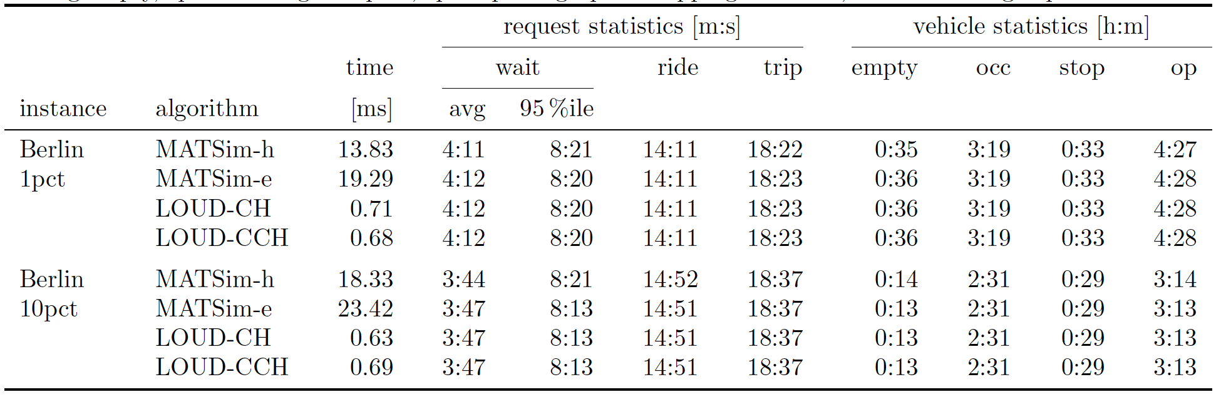
Comparative
Notes:
Comparison of LOUD to the heuristic MATSim algorithm (and its exact variant). We report the average
running time per request and statistics about the solution quality. For requests, we report the average and 95th
percentile of the wait times, and the average ride and trip time. For vehicles, we report the average time spent
driving empty, spent driving occupied, spent picking up or dropping o riders, and the average operation time.

Slide 17
Conclusion
LOUD algorithm for large scale dynamic ridesharing
Modern approach with many-to-many problem (BCH)
Great performance < 1 ms, 30 times faster than current algorithms
Future work: benchmark LOUD on larger instances

